Slide 1

Research paper on Airbnb data

Slide 2
Agenda
Introduction
Hypothesis
Literature Review
Research Design and Methodology
Key Findings
Conclusion

Slide 3

Introduction
If you have ever planned a vacation there is a good chance, you are familiar with Airbnb. Airbnb is an online platform which offers lodging, primarily homestays, or tourism experiences.
It acts as a broker receiving commission from each booking. The company is based in San Francisco, California, USA. Airbnb is a shortened version of its original name Airbedandbreakfast.com.
As users continuing to grow from both the supply and demand side, homeowners may find it hard to properly price their property. By recognizing this there were lot of considerable research projects into suggesting pricing from supply side standpoint. Having said that, our research is also about to understand what factors are mostly impacting Airbnb prices.

Slide 4

Hypothesis
What are the top neighborhoods with the greatest number of listings?
What are the different kinds of room types and Property types?
Price variance in top neighborhoods
Recommending the best host for customers based on reviews
What factors influence the price decision

Slide 5

Literature review
Majority of Airbnb research has been published quite recently, often in hospitality/tourism journals, and the research has been conducted primarily by researchers in the USA/Canada and Europe. Based on the content analysis, the papers were divided into six thematic categories – Airbnb guests, Airbnb hosts, Airbnb supply and its impacts on destinations, Airbnb regulation, Airbnb’s impacts on the tourism sector and the Airbnb company.
By reviewing a large body of literature on a novel and timely topic, this research provides a concise summary of Airbnb knowledge that will assist customers and hosts as they adapt to the recent rapid emergence of Airbnb.

Slide 6
Research Design and methodology
Data Collection
Evaluating the model
Results
Data Exploration
Deciding an algorithm
Data Processing
Training a Model

Slide 7

Data Collection
The data is collected from Inside Airbnb official website http://insideairbnb.com/get-the-data.html
The data has listings of Airbnb Los Angeles data. This data is a real time data, and it is last updated on Feb 7, 2021.
The data set contains total of 31900 Airbnb listings and 33 features of these listings
The data set has both numerical and categorical features such as host id, host name, neighborhood, latitude, longitude, room type, price, number of reviews etc.

Slide 8

data Exploration
Neighborhoods
Room type and Property types
Accommodates
Advice to the tourists
Finding a good host

Slide 9
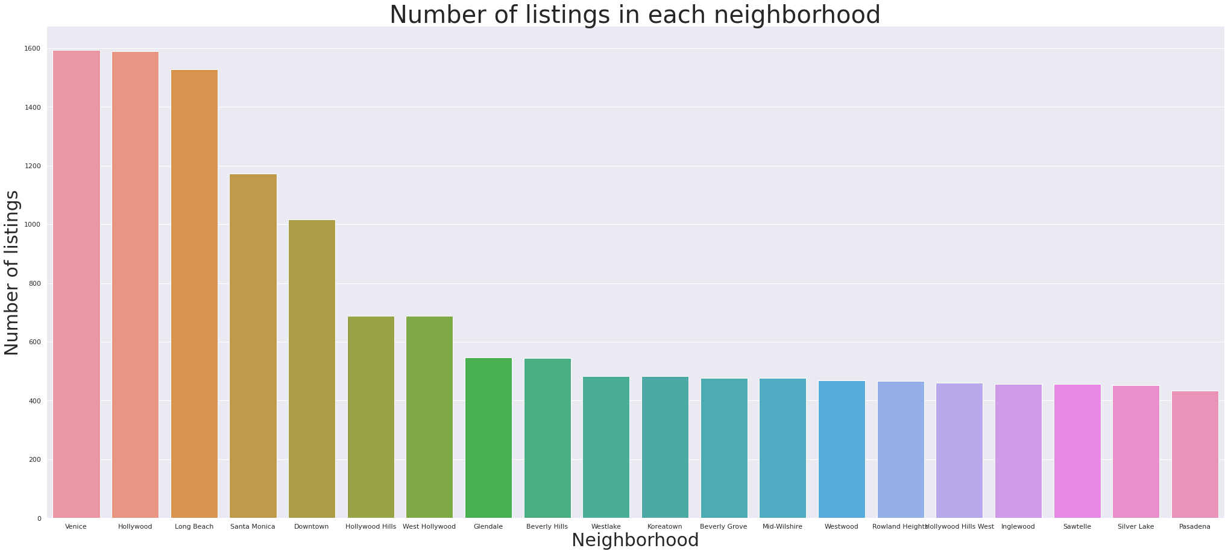

Slide 10
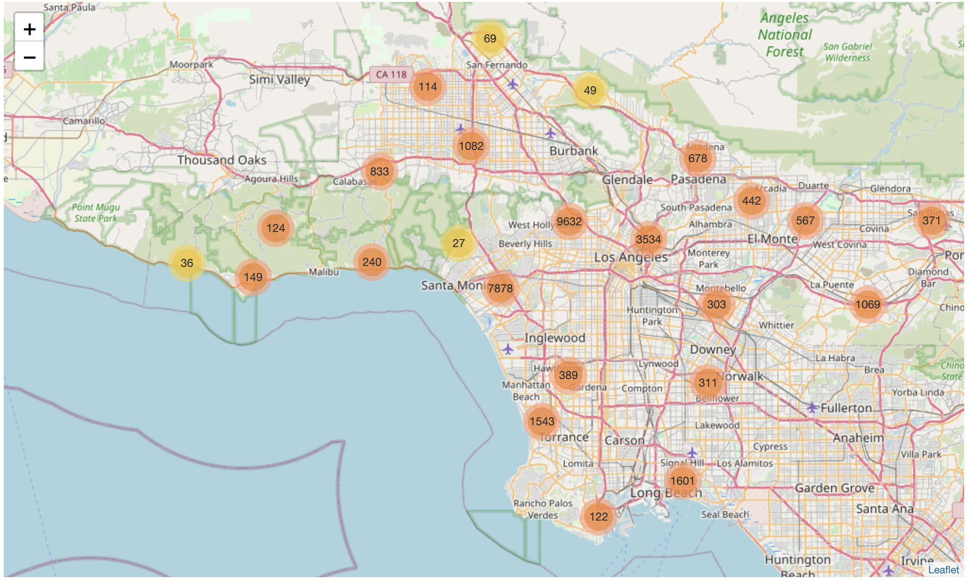

Slide 11
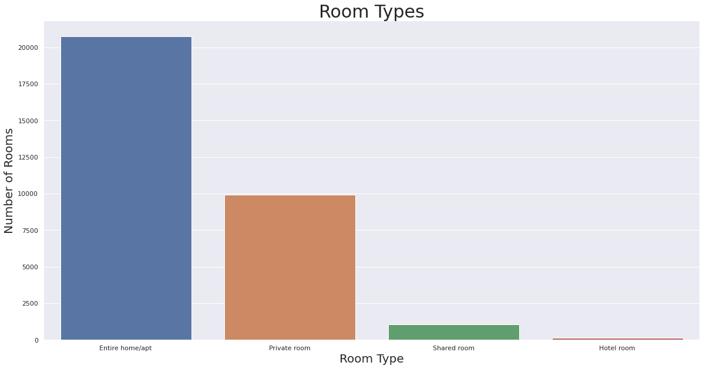

Slide 12
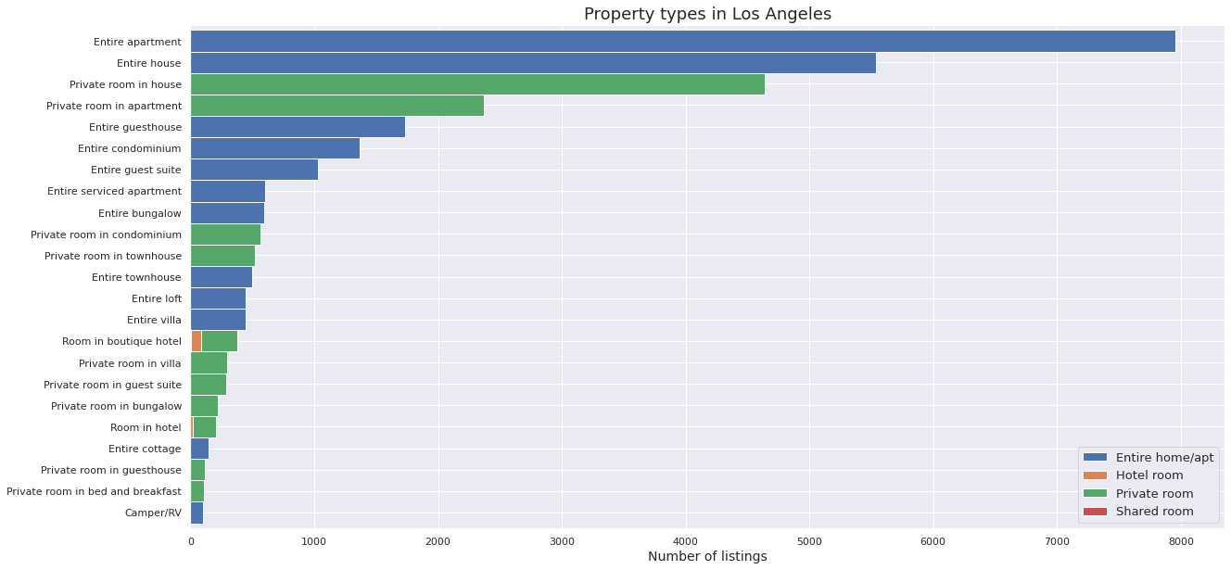

Slide 13
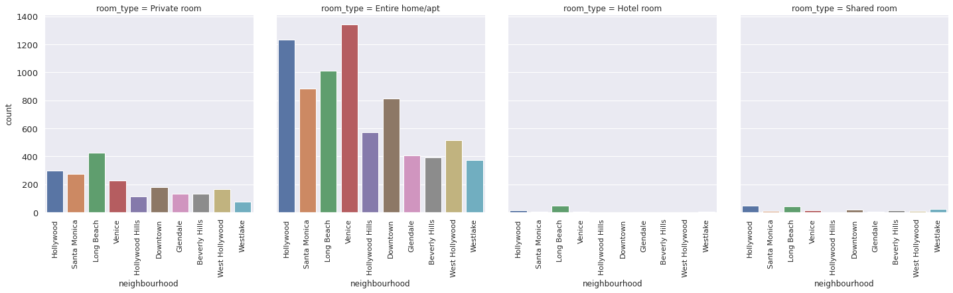

Slide 14
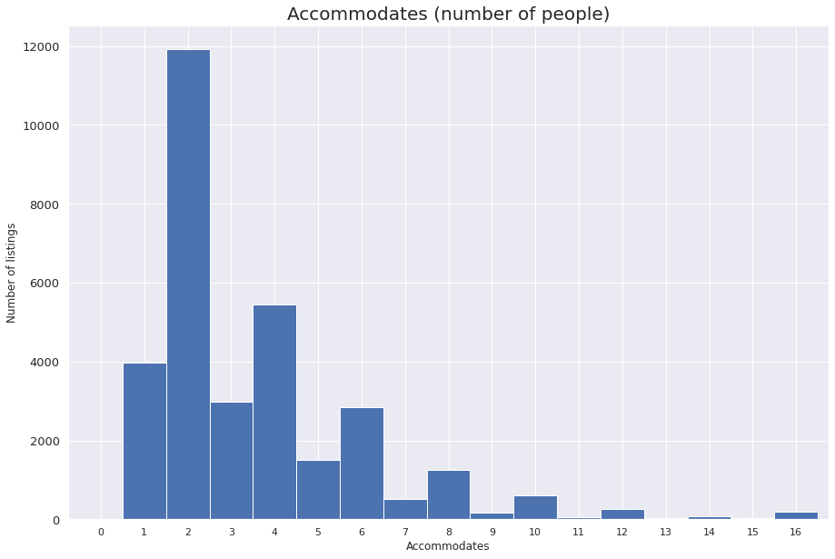

Slide 15
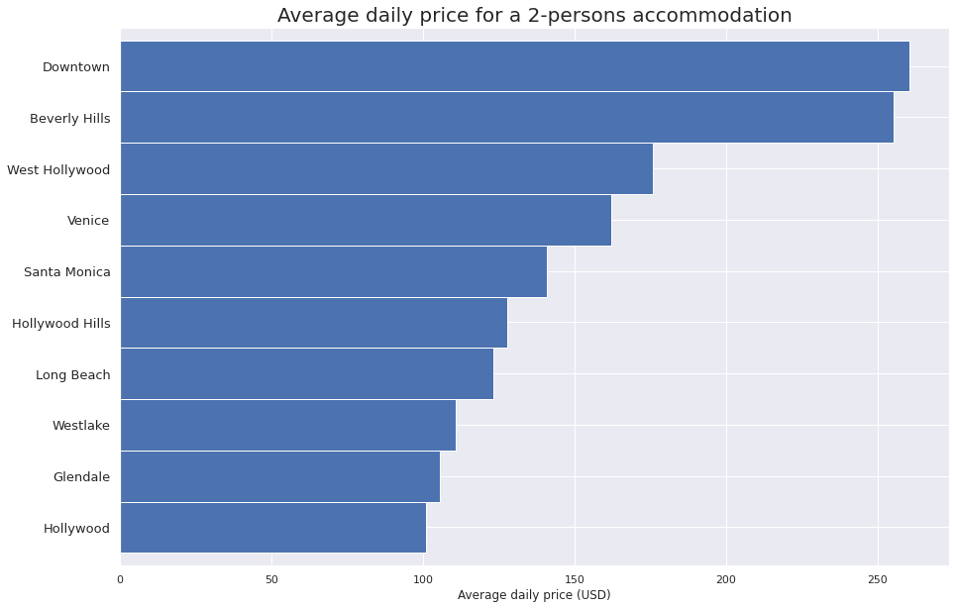

Slide 16
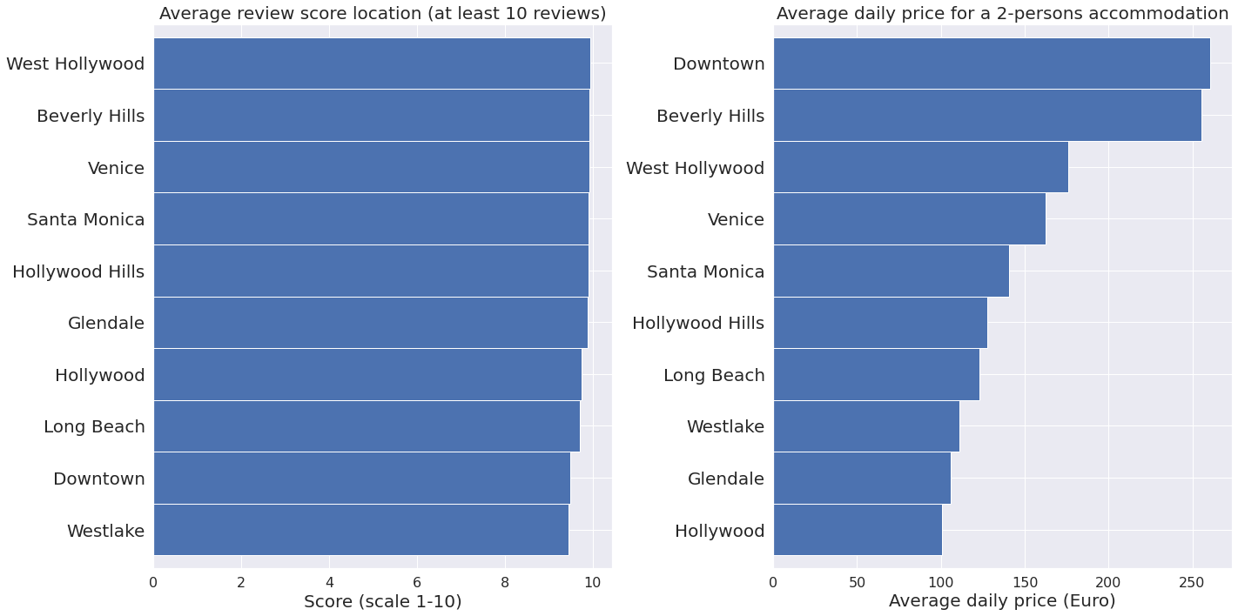

Slide 17
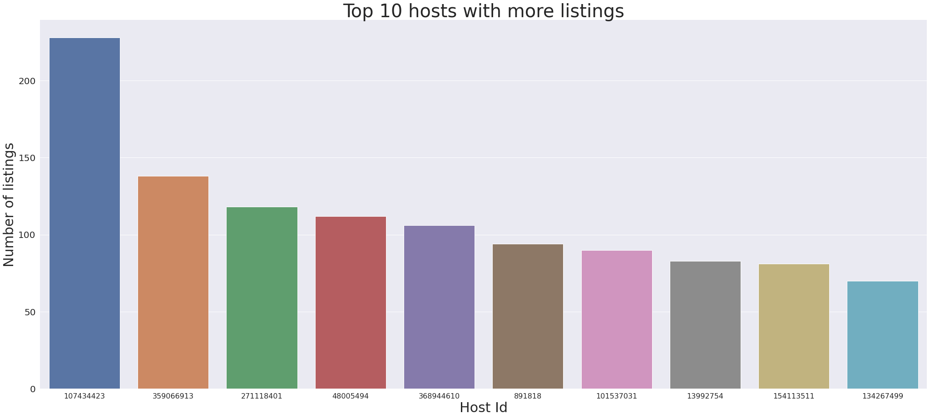

Slide 18
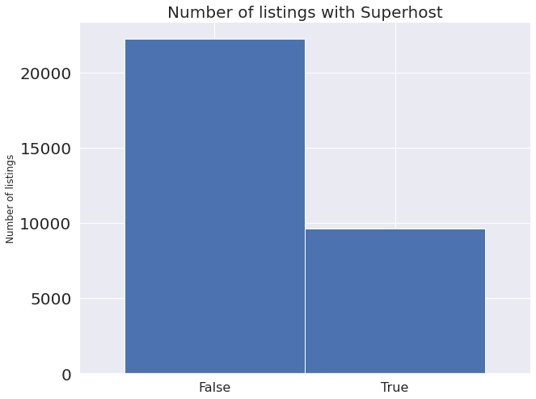

Slide 19

Deciding an algorithm
Linear Regression is used to develop a model that can predict the Airbnb prices
Linear regression models are used to show or predict the relationship between two variables. The factor that is being predicted (the factor that the equation solves for) is called the dependent variable. The factors that are used to predict the value of the dependent variable are called the independent variables.
In this research price is the dependent or target variable and other features are predictors

Slide 20
Data Processing
Build a profile of the data
Handling missing data
Checking the feature distribution
Finding the correlation
Residual plots
Feature selection

Slide 21
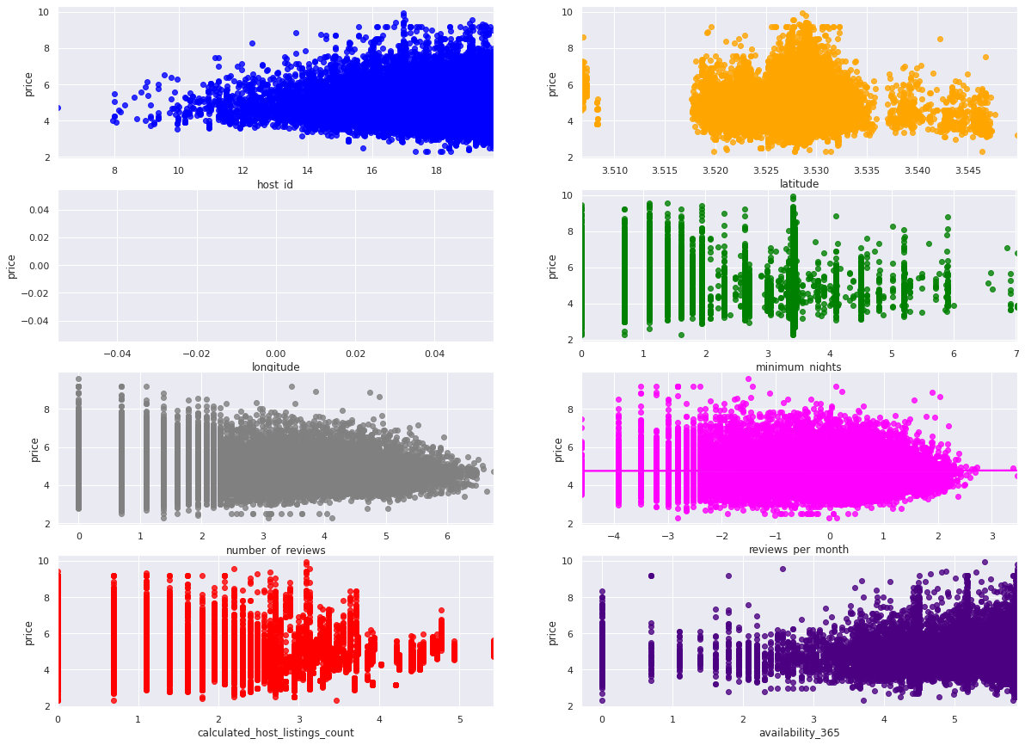
Residual plots

Slide 22

Training a model
Splitting the data into Train and Test sets
The data is split into 70% for training and 30% for testing the model
The trainings sets are given to the linear regression algorithm to to build the model

Slide 23
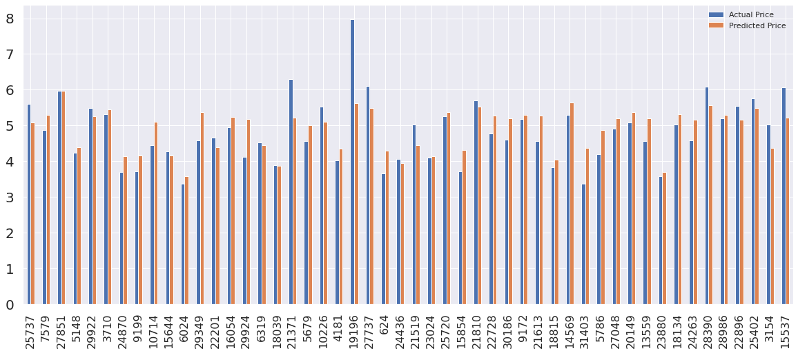
Price prediction results

Slide 24
Conclusion
The Airbnb prices depend on various factors. In this research we could see how different factors influence Airbnb prices. We have explored the data in way that a nontechnical person can easily understand trends in Airbnb price changes based on neighborhood, room type, property type etc. This research also gives an important insights to the hosts in terms of deciding prices. Hosts could understand what factors they should consider mostly while deciding price and what factors a customer should consider while booking.
“All models are wrong, but some are useful”

Slide 25

Thank you

